Slide 1

Safe Beaches for ALL Chicago IL
By: Sarah Eiden, Anna Chee, Noni Bell and Jorge Daniel Atuesta

Slide 2
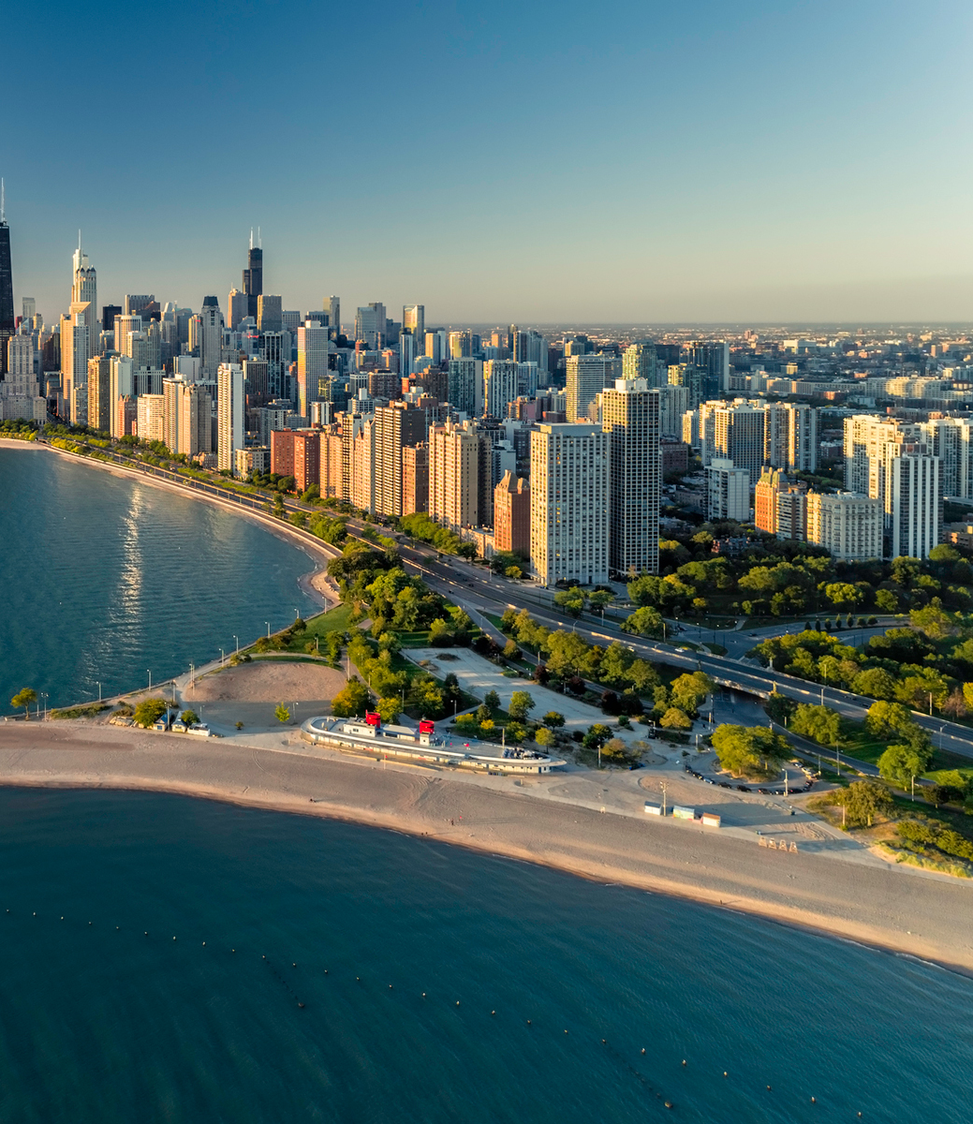
Purpose
Inspired by these articles concerning precipitation effects on the Chicago river and Lake Michigan, we set out to predict one serious consequence of a changing climate. By training a machine algorithm to analyze weather data (rainfall, air temperature, and water temperature) and incidence of e. coli in beaches, we hope to better predict how precipitation can affect waterborne diseases as well as protect beachgoers.

Slide 3
Process
Brainstorm ideas for the project
Decided what data to use
Cleaned the data
Build the Machine Learning algorithm
Build data base
Create Python App
Create the HTML
Deployed the App

